Slide 1
Music Generator
Final project presentation CSCI 6221
Team member:
A Zhenyi Yuan
B Dongfang Zhao
C Yihan Chen

Slide 2
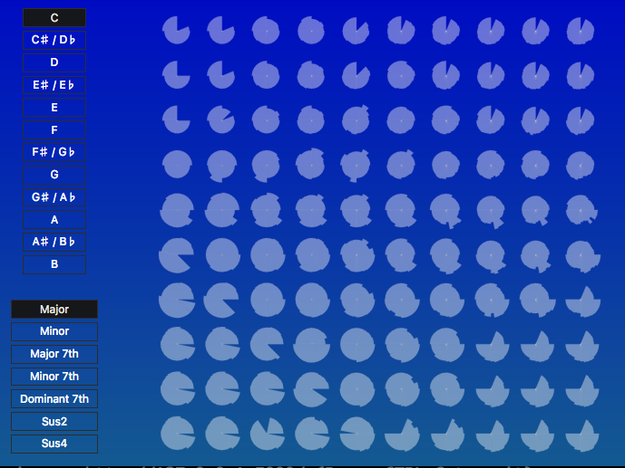
1.Introduction
2.Our features
3.Our values
4.Model
Notes:
四个部分：
1.为什么做这个
2.项目功能
3.和其他比较，我们的优点
4.模型介绍

Slide 3
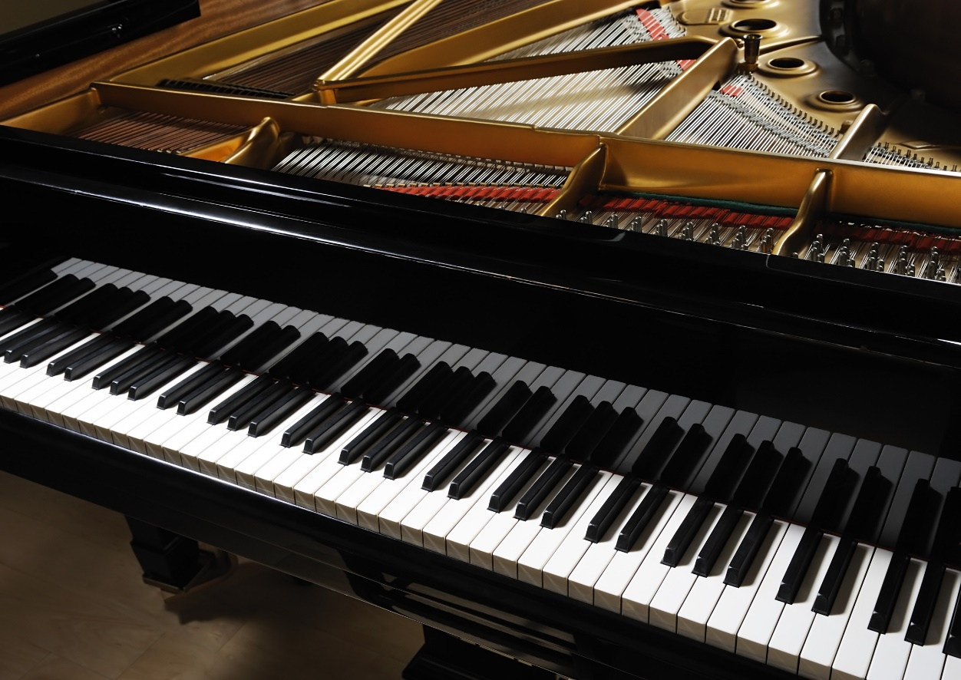
1.Introduction
Why we do this?
An easy way to help non-professional people
Provide more ideas to professional people
A faster way to generate music with your prefer
Notes:
这里列出了三个项目的出发点

Slide 4
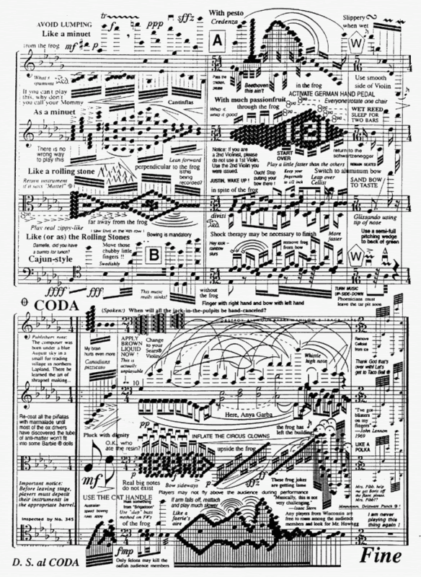

YOUR Own music-for non-professional
Complex
Much idea
Notes:
人们喜欢音乐，对于新手，难学；很多想法却不成曲子；

Slide 5
2.Our Features
1. Multiple major selection
2. 10 * 10 generated tones by LSTM
3. Real-time result feedback
4. MIDI file output

Slide 6
3.Our Values
Jukedeck
https://www.jukedeck.com/make/tracks/browse
Fake Music
https://www.fakemusicgenerator.com/
Beat Blender
https://experiments.withgoogle.com/ai/beat-blender/view/
Latent Loops
https://teampieshop.github.io/latent-loops/

Slide 7
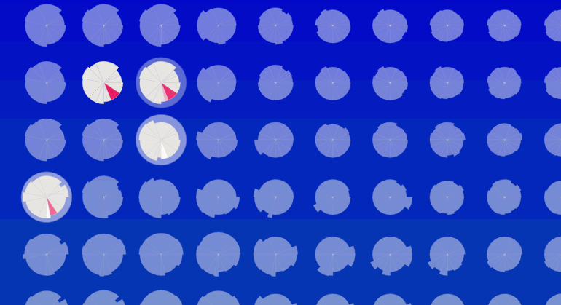
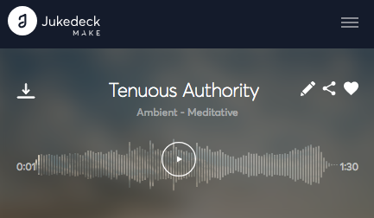
3.1 Compare with Jukedeck
Free
Our project is free, which means you can share your music with your friends.

Slide 8
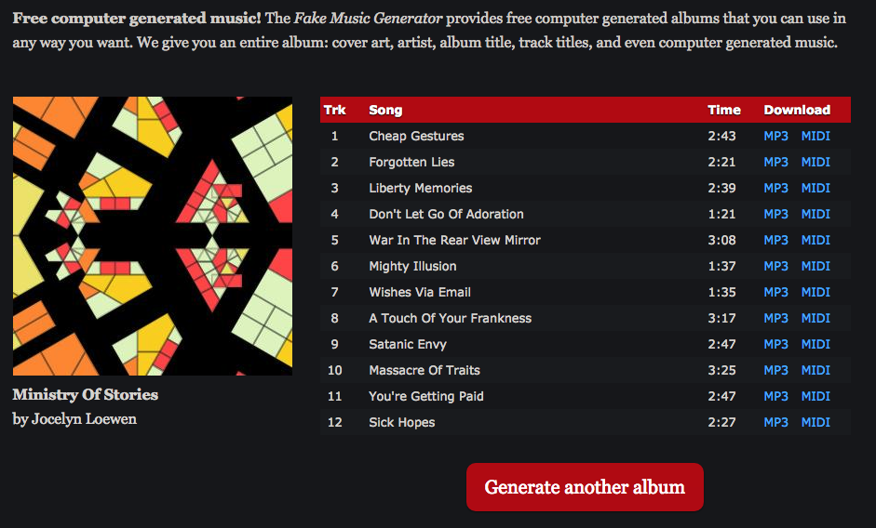
3.2 Compare with Fake Music
Real-Time
Our project gives users a real-time feedback of their creation

Slide 9
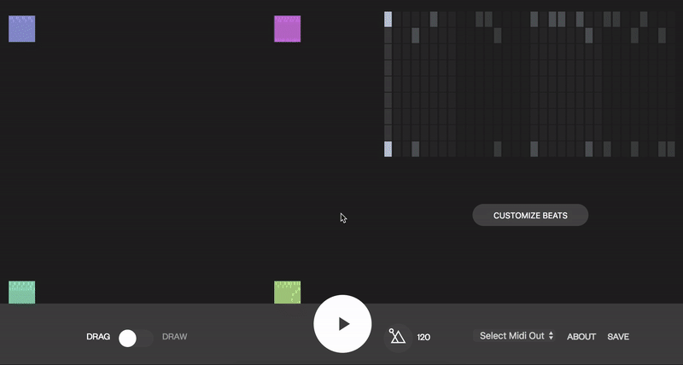
3.3 Compare with Beat Blender
Output MIDI File
Our project can generate MIDI file and also provide more scheme for users.

Slide 10

3.4 Compare with Latent Loops
Mix Music
Our project can mix music together at the same time, compared with Beat Blender

Slide 11
3.5 Conclusion
 | Jukedeck | Fake Music | Beat Blender | Latent Loops
Our Value | Free | Real-time | Mix Music | Output MIDI file

Slide 12
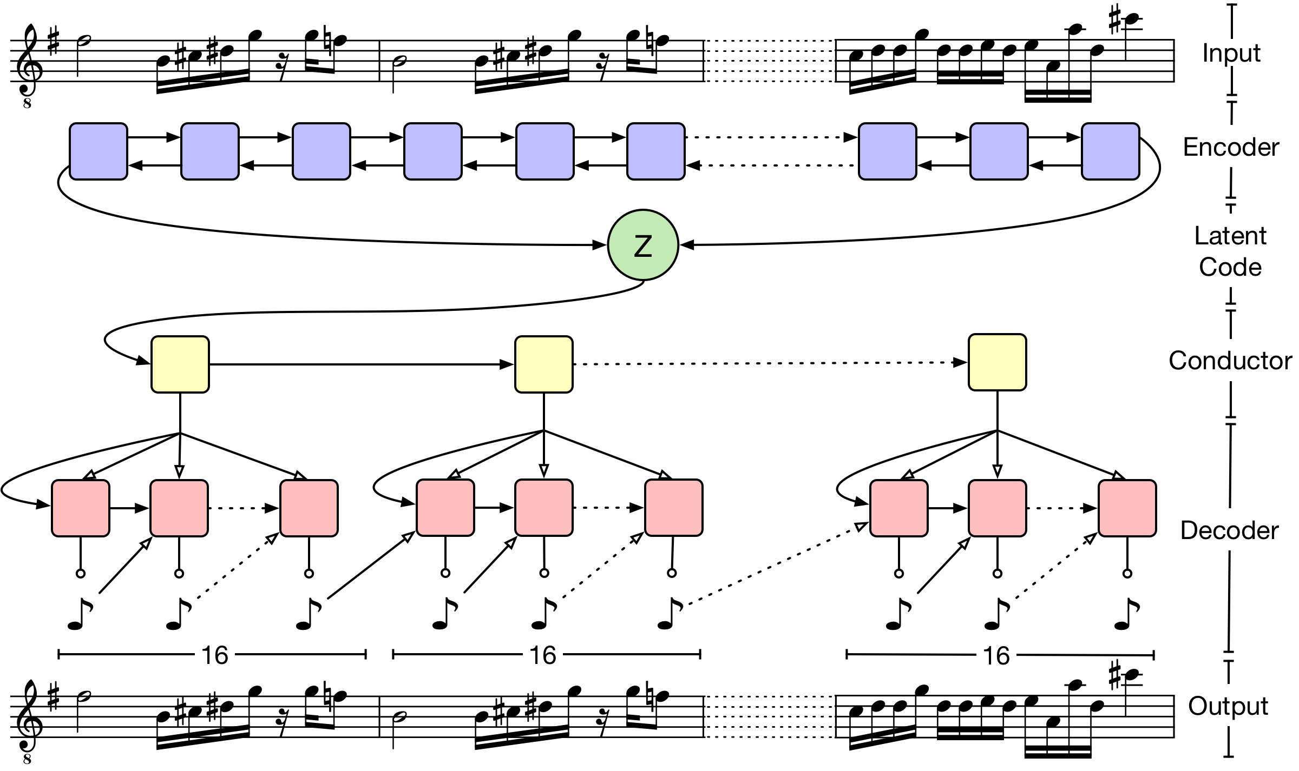
4.Model
One layer LSTM with 2048 state sites and output 512 latent dimension
Full-connected layer followed by tanh activation
Two layer LSTM, each module of the second layer is made up by 16 embedding matrix generated from the first layer
Roberts, A., Engel, J., Raffel, C., Hawthorne, C., & Eck, D. (2018). A Hierarchical Latent Vector Model for Learning Long-Term Structure in Music. arXiv preprint arXiv:1803.05428.

Slide 13
THANK YOU
Entrepreneurial activities
Entrepreneurial activities differ substantially depending on the type of organization.

